Slide 1


CSE 4120: Image Processing & Computer Vision Laboratory
Title: Tree Age Determination using Ring Count
Supervised By:
Dr. Sk. Md. Masudul Ahsan
Professor
Department of Computer Science and Engineering
Khulna University of Engineering & Technology
Dipannita Biswas
Lecturer
Department of Computer Science and Engineering
Khulna University of Engineering & Technology
Presented by: Atiqul Islam Atik
Roll: 1907107
Year: 4th
Semester: 1st
Department of Computer Science and Engineering
Khulna University of Engineering & Technology

Slide 2
Outline
Introduction
Application
Key Steps
Methodology Explanation
Result Analysis
Limitations
Conclusion
References

Slide 3
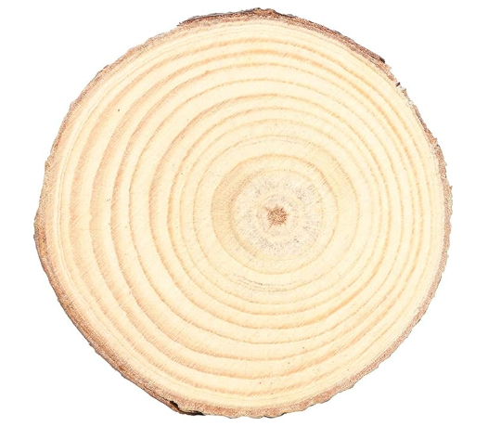
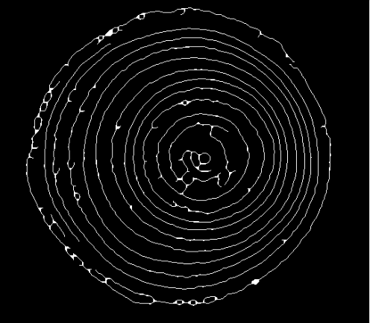
Introduction
Tree ring analysis, also known as dendrochronology, is a scientific method of dating based on the analysis of patterns of tree rings.
Each ring typically represents one year of growth, making it possible to determine the age of the tree.
Tree Age: 13 (years)
Fig-1: Input Tree Cross Section Image
Fig-2: Output Tree Age

Slide 4
Key Steps
Segmentation Tree Cross Section Part
Local Histogram Equalization
Gamma Correction
Remove Noise (Gaussian Blur, Median Filter)
Adaptive Thresholding
Morphological Operation (Opening)
Skeletonization (thinning)
Morphological Operation (Closing)
Tree Ring Count

Slide 5
Applications
Tree Age Estimation
Forest Management
Tree Growth Rate Analysis
Ecology and Biodiversity Studies
Wood Quality Assessment

Slide 6
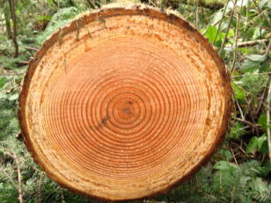
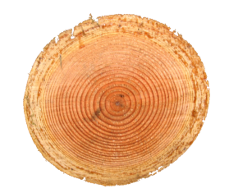
Methodology (Segmentation)
Tree cross-section image segmentation means isolating the circular or oval-shaped region that represents the cross-section of a tree trunk from an image.
Convert RGB image to grayscale.
Apply Otsu's method to threshold the image.
Fill holes in the binary image.
Label and identify the largest region (tree cross-section).
Create a mask for the tree region.
Isolate the tree and background to white.
Convert the result back to a BGR image.
Fig-3: Original Image
Fig-4: Segmented Image

Slide 7
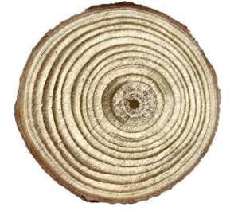
Methodology (Local Histogram Equalization)
Local histogram equalization is a technique used to enhance the contrast of an image, particularly in regions where the contrast is poor
Convert image to LAB color space
Split the LAB image into L, a, and b channels.
Apply CLAHE to L-channel
Merge enhanced L-channel with original a and b channels.
Convert back to BGR color space
Fig-5: Input Tree Cross Section Image
Fig-6: Local Histogram Equalization

Slide 8
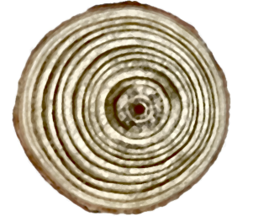
Methodology (Gamma Correction)
Gamma correction is a nonlinear operation used to adjust the brightness or contrast of an image. Here are the steps involved in gamma correction:
Set Gamma value (1.5)
Calculate inverse of Gamma
Create a lookup table to adjust pixel intensities
Generate an array for values from 0 to 255.
Apply gamma correction formula for each value in the array.
Apply the lookup table to perform gamma correction on every pixel.
Fig-7: Gamma Corrected Image

Slide 9

Methodology (Thresholding)
Adaptive thresholding is a method used in image processing to automatically binarize (convert to black and white) images based on local pixel intensity variations.
Blur the image to reduce noise and smooth intensity transitions.
Compute adaptive thresholds for small-pixel neighborhoods.
Use the specified algorithm
Specify whether to invert the binary image
Adjust parameters such as block size and constant to optimize thresholding based on image characteristics.
Fig-8: Adaptive Thresholding Output

Slide 10
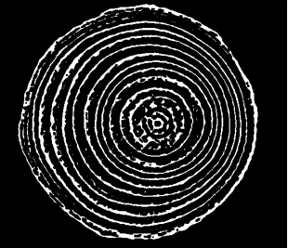

Methodology (Morphological Opening)
Morphological opening is a fundamental operation in image processing that consists of two sequential operations: erosion followed by dilation.
Erosion: Uses a 3x3 kernel to erode . Removes small bright regions
Dilation: Applies dilation using the same kernel size. Restores the eroded parts
Fig-9: Eroded Image
Fig-10: Dilated Image

Slide 11

Methodology (Apply Mean Filter)
A mean filter, also known as an average filter, is a type of linear filter commonly used in image processing to smooth images by averaging the pixel values within a defined neighborhood.
Kernel Size: (3,3) and (5,5)
Impact: Mean filtering is effective for reducing salt-and-pepper noise but may not preserve fine details well.
Fig-10: Dilated Image
Fig-11: Apply Mean Filter

Slide 12
Methodology (Morphological Closing)
Morphological closing is a technique in image processing used to close small holes or gaps in foreground objects, as well as to smooth the boundaries of foreground objects. It typically involves two main operations: dilation followed by erosion.
Kernel Size: (3,3)
Impact: filling small gaps
Fig-12: Morphological Closing

Slide 13
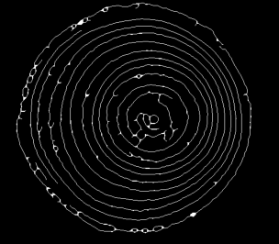
Methodology (Thinning)
The skeleton of an image, in image processing, refers to a representation of the image where only the essential features (like lines or curves) that represent its shape are preserved.
Ensure the input image is binary (0 or 255).
Apply Zhang-Suen morphological thinning to process the binary image.
Convert the thinned image back to 8-bit format (0 or 255).
Output the thinned image.
Fig-13: Skeleton Image

Slide 14
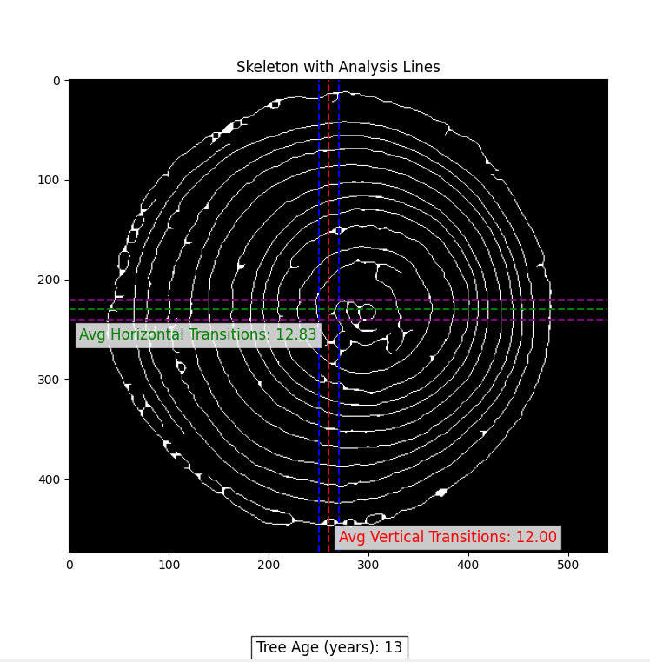
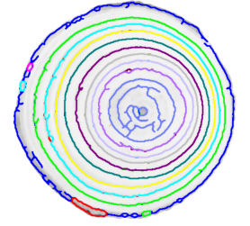
Result Analysis
To estimate tree rings from a skeletonized image, I have used the average number of transitions along both vertical and horizontal lines as a proxy for ring count.
Determine the top-most, bottom-most, left-most, and right-most points of the skeleton image
Draw a vertical line and a horizontal line
Count the pattern (black-white)
Add two more parallel and vertical line
Then average all line’s output
Tree ring = (pattern count / 4 )
Fig-14: Tree Age Determining Using Ring Count

Slide 15
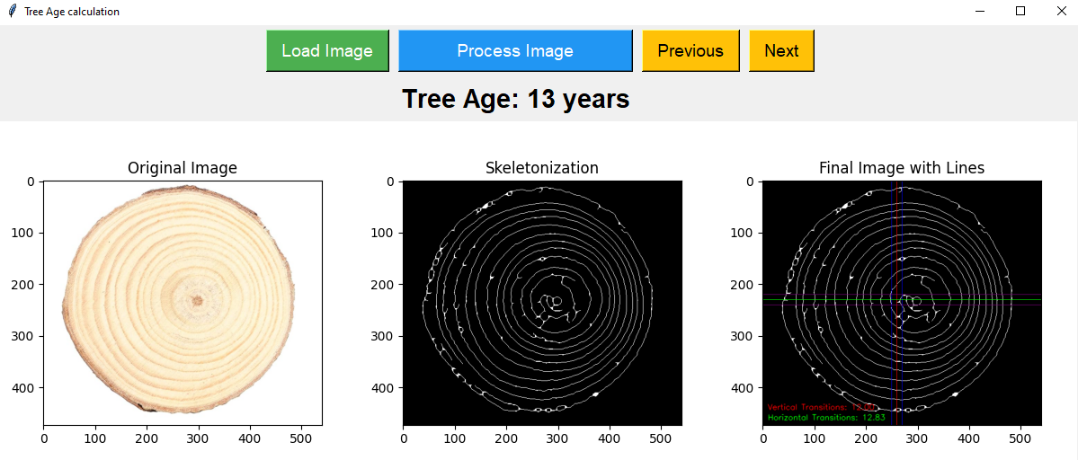
Result Analysis
This is the Graphical User Interface (GUI) for loading an input image showing all steps and determining the tree age.

Slide 16
Limitations
There are some challenges. Here are some specific limitations to tree ring count estimation:
Misidentification or omission of tree rings due to poor contrast or overlapping growth rings
Non-circular or irregular cross-sections may present challenges in standardizing the ring detection process.
Irregular shapes may pose challenges for consistent ring detection
The sided Tree center may degrade the ring count technique
Presenting very small width among rings creates challenges

Slide 17
Conclusion
These are the conclusions of the tree ring count project:
Effective Segmentation: Successfully isolates and highlights tree rings
Enhanced Detection: Improves accuracy with advanced techniques
Variability Challenges: Needs refinement for diverse image conditions
Automation Potential: Promising for large-scale dendrochronology.
Future Work: Focus on robustness and 3D analysis

Slide 18
References
[1] P. M. Sundari, S. B. Ramesh Kumar and A. J. Sahayaraj, "An Approach for Analyzing the Factors Recorded in the Tree Rings Using Image Processing Techniques," 2017 World Congress on Computing and Communication Technologies (WCCCT), Tiruchirappalli, India, 2017, pp. 236-239, doi: 10.1109/WCCCT.2016.65. keywords: {Image edge detection;Feature extraction;Meteorology;Vegetation;Algorithm design and analysis;Shape;dendrochronology;dendroclimatology;tree ring},
[2] S. S. P. Gannamani, P. Srivani, S. Adarsh, V. Shashank and M. Bharath Shreya, "Tree Age Predictor Using Augmented Reality and Image Processing Techniques," 2021 IEEE International Conference on Computation System and Information Technology for Sustainable Solutions (CSITSS), Bangalore, India, 2021, pp. 1-6, doi: 10.1109/CSITSS54238.2021.9683736. keywords: {Biological system modeling;Instruments;Scalability;Vegetation;Predictive models;Data models;Climate change;Tree age Predictor;deforestation;Augmented Reality(AR);Machine Learning(ML);Internal Calculation;Internal rings;increment Borer},
[3] Schweingruber, F.H., 2012. Tree rings: basics and applications of dendrochronology. Springer Science & Business Media.
[4] Baillie, M.G., 2014. Tree-ring dating and archaeology. Routledge.

Slide 19
Thank You

